Slide 1
REMOTELY OPERATED VEHICLE (ROV)
ROBOTIC SYSTEM
KHAIRYL MUADZ BIN ROSLAN

Slide 2
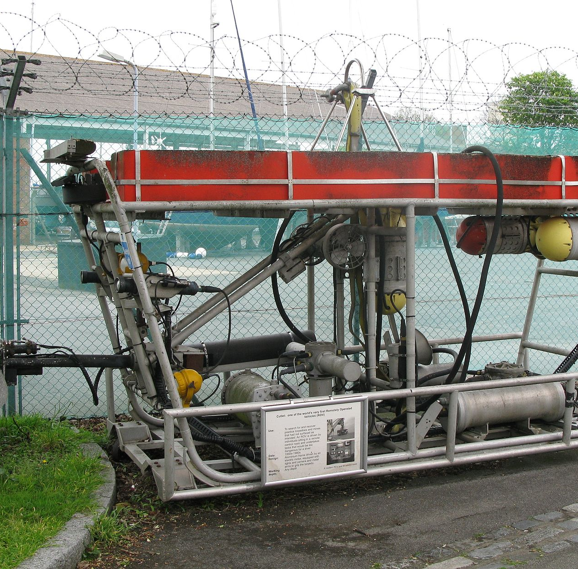
HISTORY
Submersible ROVs have been used to locate many historic shipwrecks, including the RMS Titanic and SS Central America.
The U.S. Navy funded most of the early ROV technology development in the 1960s into what was then named a "Cable-Controlled Underwater Recovery Vehicle" (CURV). This created the capability to perform deep-sea rescue operation and recover objects from the ocean floor, such as a nuclear bomb lost in the Mediterranean Sea after the 1966 Palomares B-52 crash.

Slide 3
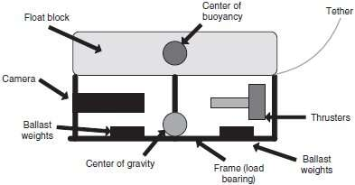
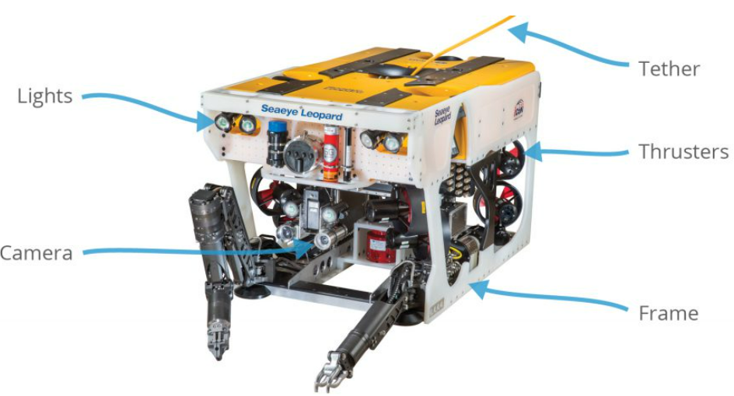
PHYSICAL DESIGN
Robustness, water-resistance, pressure-resistance and hardware placements.
The robot has its equipment protected, especially the battery and control box which are sealed.
Commonly rectangular, some ROVs are built with highly specialized frames to reduce drag, improve appearance, or perform special missions.
Plastic materials such as polycarbonate and nylon are commonly used in ROV and subsea applications.
For deep ocean missions, tether cables with high performance and reliability needed for efficient and accurate control, providing the required strength to support the vehicle (e.g. Kevlar strength member cables).
Radio waves don’t travel far through water, so it’s difficult operating an ROV with modern wireless technology.

Slide 4
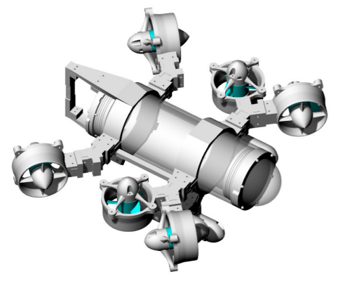
PROPULSION & ACTUATORS
Use of holonomic structure with two vertical motors as thrusters.
Design as the picture suggests makes the ROV a very flexible robot.
Addition of two more vertical thrusters makes the robot a 6-DOF robot (similar to BlueROV2 Heavy Configuration)
As the vertical thruster are placed close to the center of mass of the robot, upward and downward movements are possible.
Actuators are usually grippers to retrieve objects.

Slide 5
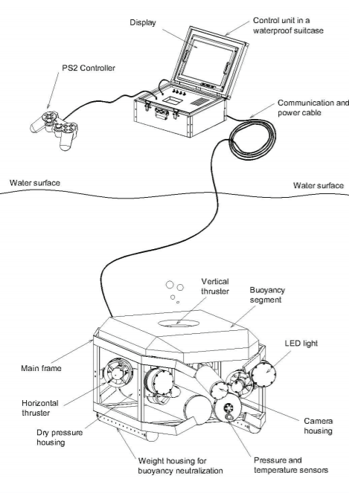
NAVIGATION SYSTEM
Control using umbilical wire, obstacle avoidance, Sonar and other sensors.
Umbilical wire is attached from the computer to the control box.
In this ROV design Electronic Speed Controllers (ESC) are used to control the thrusters, their speed and rotation. Each DC Motor is connected to its own ESC.
A Raspberry Pi V2.1, 8 MP 1080P camera module is installed on the Raspberry Pi to stream HD videos to the surface computer. The image displayed may be used for obstacle avoidance and data acquisition.
Ping360 Scanning Sonar can be used to detect objects in radius of 50 meters, using open source software as interface. This is usually used in unclear environments.
Gyroscope and accelerometer are use also used.

Slide 6
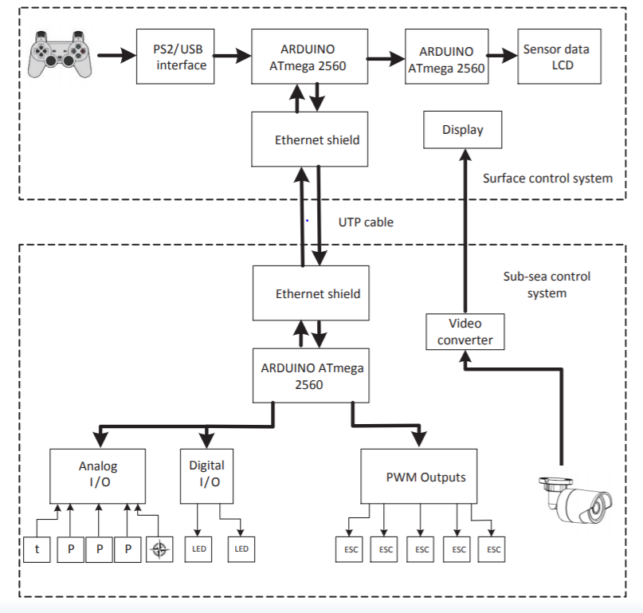
PROPULSION OVERVIEW

Slide 7
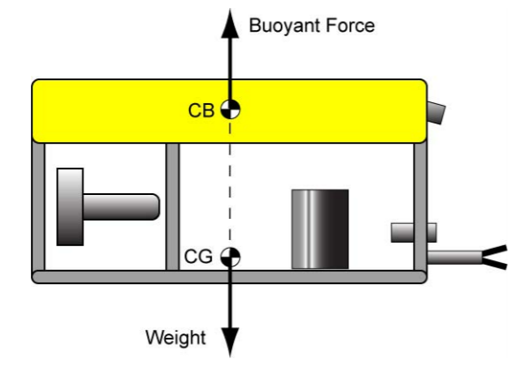
NEUTRAL BUOYANCY
Neutral buoyancy will ensure the ROV stays in its current position with stability.
The system is constructed with a high center of buoyancy and a low center of gravity, to give the camera platform maximum stability about the longitudinal and lateral axis.
Adjustable ballast weight system located at the bottom of the ROV frame is used to achieve neutral buoyancy, as the opposite uplift force is achieved by the buoyancy block located on the upper side of the ROV. Placement of weight and foam is collinear.

Slide 8


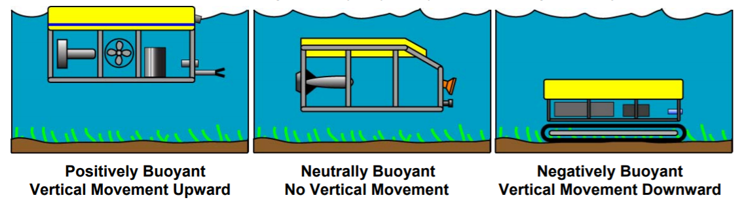
NEUTRAL BUOYANCY
Neutral
Buoyancy
Buoyant force = weight, the object neither floats or sinks
Syntactic foams are designed to provide the highest possible buoyancy and ballistic weight is placed to neutralize the buoyancy.
Ballistic
Weight
This item adds to the weight to neutralize ROV’s buoyancy

Slide 9
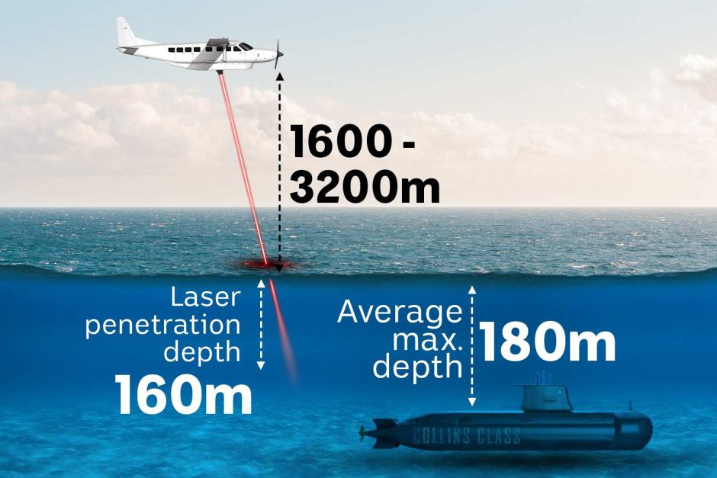
DATA COLLECTION & TRANSMISSION
Multiple sensors are used to detect the parameters needed.
Accelerometers are used to detect the position of the ROV.
Magnetometer is to identify measurements of magnetic field for compassing.
Temperature and pressure sensors can also be used for data.
HD Camera is used to view and explore the ocean.
Lidar and sonar sensors can also be used to draw the map of the ocean, bathymetric Lidar systems use a green wavelength of 532nm to penetrate the water column for measuring the seafloor.

Slide 10
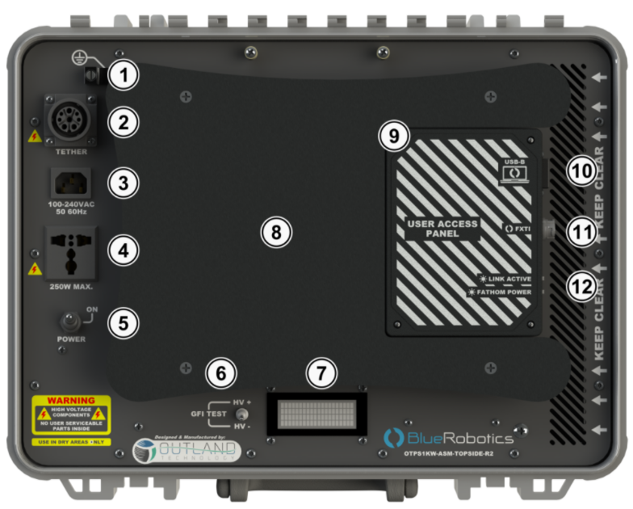
POWER MANAGEMENT
Battery box usually used and the power from umbilical wire.
The tether provides both the electrical power and allows the transfer of data between the vessel and ROV to be transmitted.
The tether connected to power supply unit can eliminate the need for batteries.
The option for batteries allows for lower cost ROV to be used.
Blue Robotics battery provide the alternative of quick-swapping batteries for long missions with 2-3 hours battery life per use.
Power is distributed to the ESCs through a Matek power distribution board, to the Pixhawk through a Power Module and to the Raspberry Pi through a 5V 3A Switching Power UBEC.

Slide 11
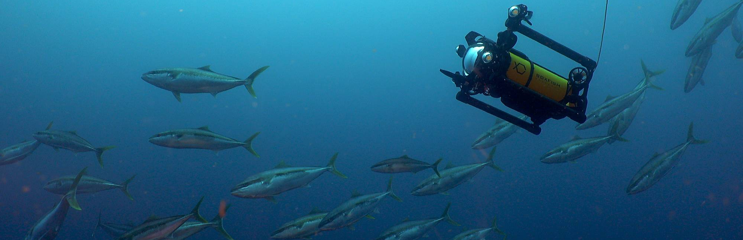
REAL LIFE APPLICATIONS
TODAY, ROV IS BEING USED FOR NEW PURPOSES SUCH AS FILMMAKING!

Slide 12
HARDWARE ITEMS
ITEMS | LINK
Basic BlueROV2 | https://bluerobotics.com/store/rov/bluerov2/
Ping360 Scanning Imaging Sonar | https://bluerobotics.com/store/sensors-sonars-cameras/sonar/ping360-sonar-r1-rp/
Newton Subsea Gripper | https://bluerobotics.com/store/rov/bluerov2-accessories/newton-gripper-asm-r1-rp/
Power Supply Unit for OTPS | https://bluerobotics.com/store/comm-control-power/powersupplies-batteries/otps1kw-asm-topside-r2/
High-Power Tether Cable with Connectors for OTPS | https://bluerobotics.com/store/cables-connectors/cables/otps1kw-cab-tether-r1-vp/
Battery Charger | https://bluerobotics.com/store/retired/lithium-battery-charger/
Add-on Kit for BlueROV2 | https://bluerobotics.com/store/rov/bluerov2-upgrade-kits/brov2-heavy-retrofit-r1-rp/
Battery Cell Checker | https://bluerobotics.com/store/comm-control-power/powersupplies-batteries/battery-cell-checker-r1/
Lidar Sensor (40m) | https://my.cytron.io/p-tf02-pro-ip65-lidar-rangefinder-40m?r=1&gclid=Cj0KCQjwmIuDBhDXARIsAFITC_7y9hN4747O88O5xAYoMqNJWbOSfHyQqaSEQyDgjqw7LXHJ_bv4hH0aAmmCEALw_wcB
Survey of hardware items required for ROV online.

Slide 13

THANK YOU!
KHAIRYL MUADZ
BIN ROSLAN

